Slide 1
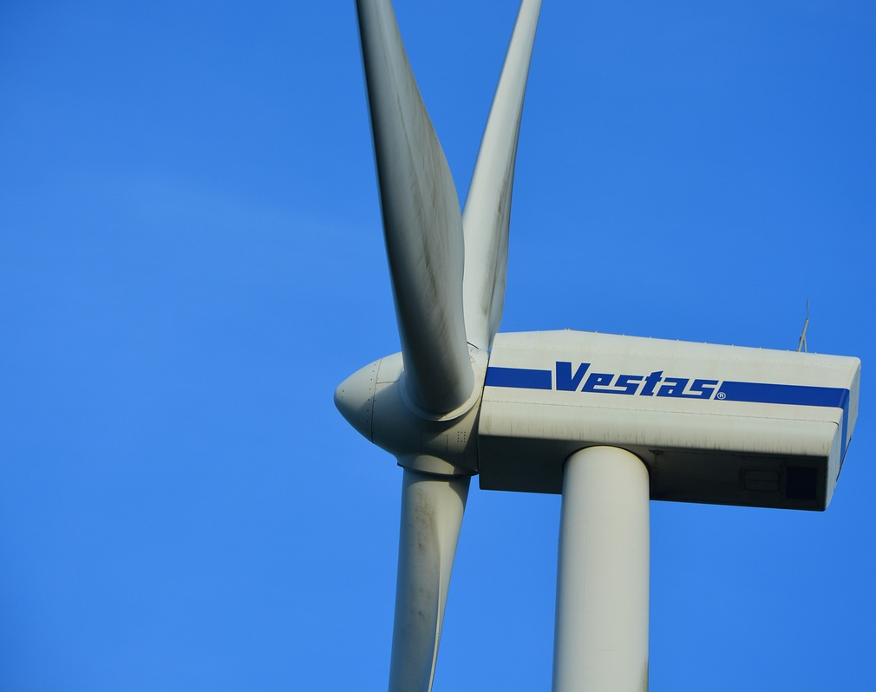
Maritime Wind Speed Prediction Using Buoy LIDAR Data
Team: Brian Waite, Carl Walenciak
Southern Methodist University
Time Series Analysis
Prof. B. Sadler

Slide 2
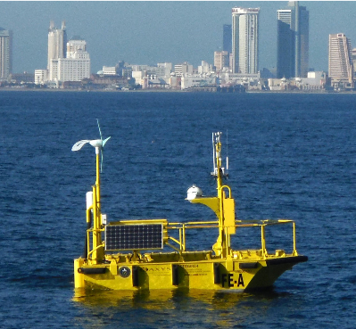
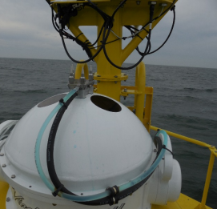
What is Buoy LIDAR Data?
Pacific Northwest National Labs (PNNL) in support of U.S. Department of Energy (DOE)
Buoy collects comprehensive meteorological and oceanographic data characterize offshore wind energy.
LIDAR – LIght Detection And Ranging
Using Data from April 2016 buoy deployment. (Specifically 01-20 April)
https://wind.pnnl.gov/lidarbuoyloanprogram.asp
https://wind.pnnl.gov/pdf/Example_Monthly_Report.pdf

Slide 3
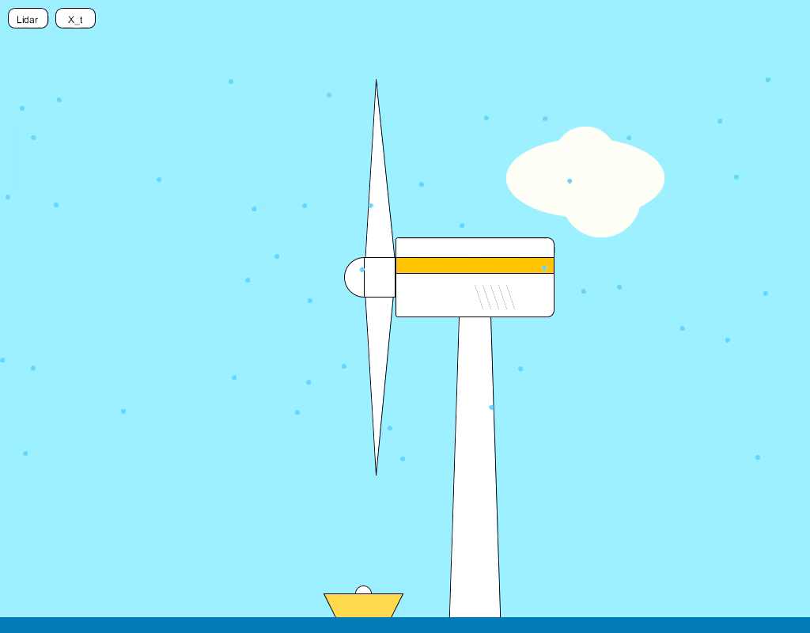

Slide 4
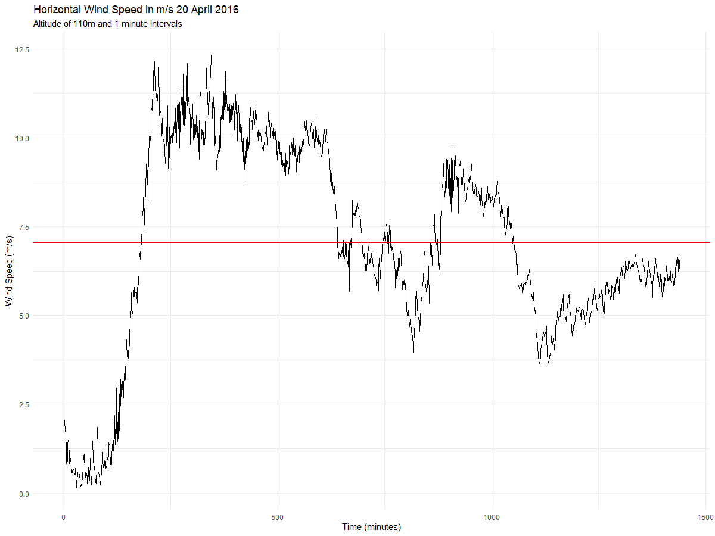
Realization
X_{bar}
But what does it mean?

Slide 5
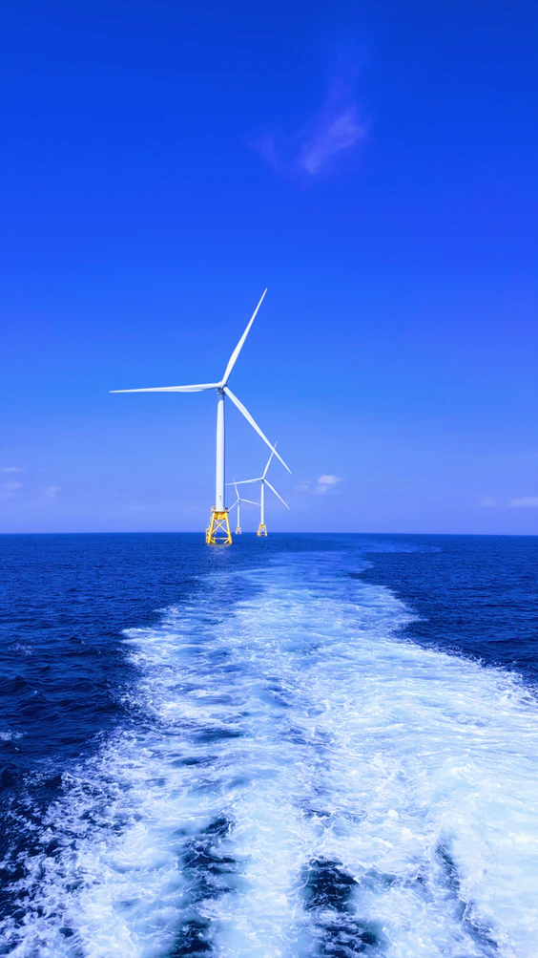
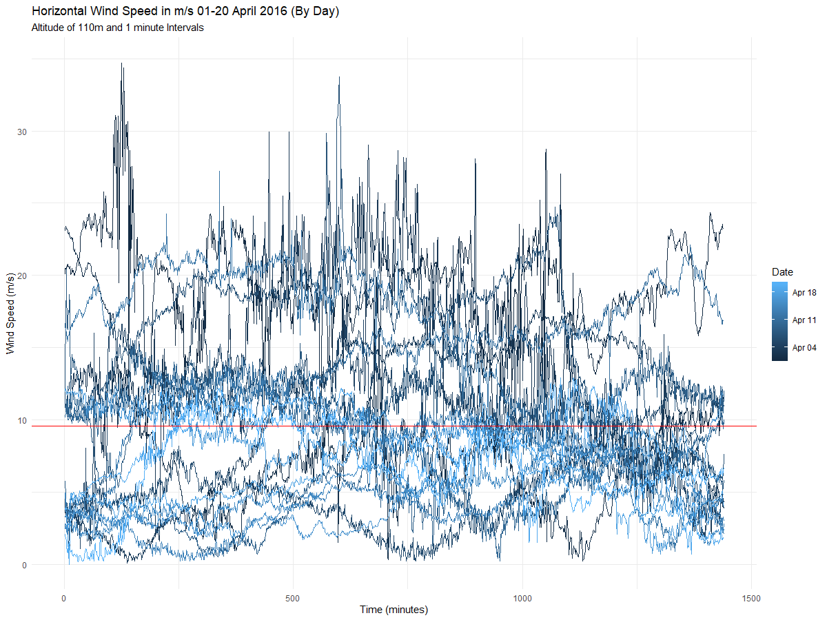
Note about distribution:
Our research indicates wind follows a Weibull distribution (right skewed), but we assume normality to be able to continue with research.

Slide 6

Stationarity Evaluation
Condition 1: Mean does not depend on time
Condition 2: Variance does not depend on time
Condition 3: Autocorrelations constant regardless of where we look in the series

Slide 7
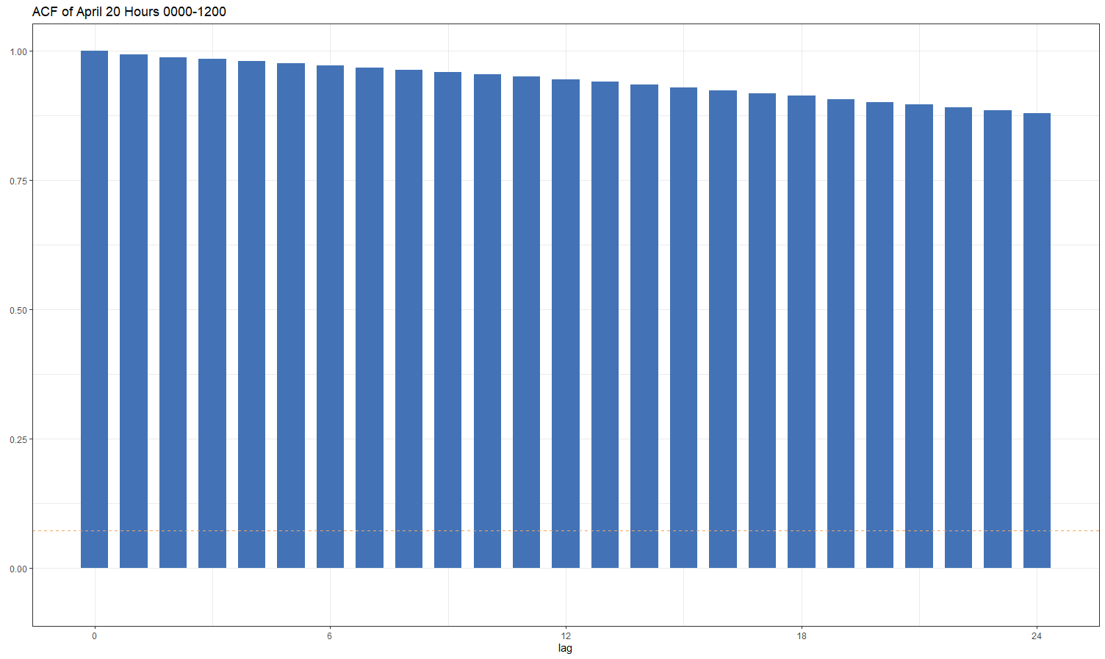
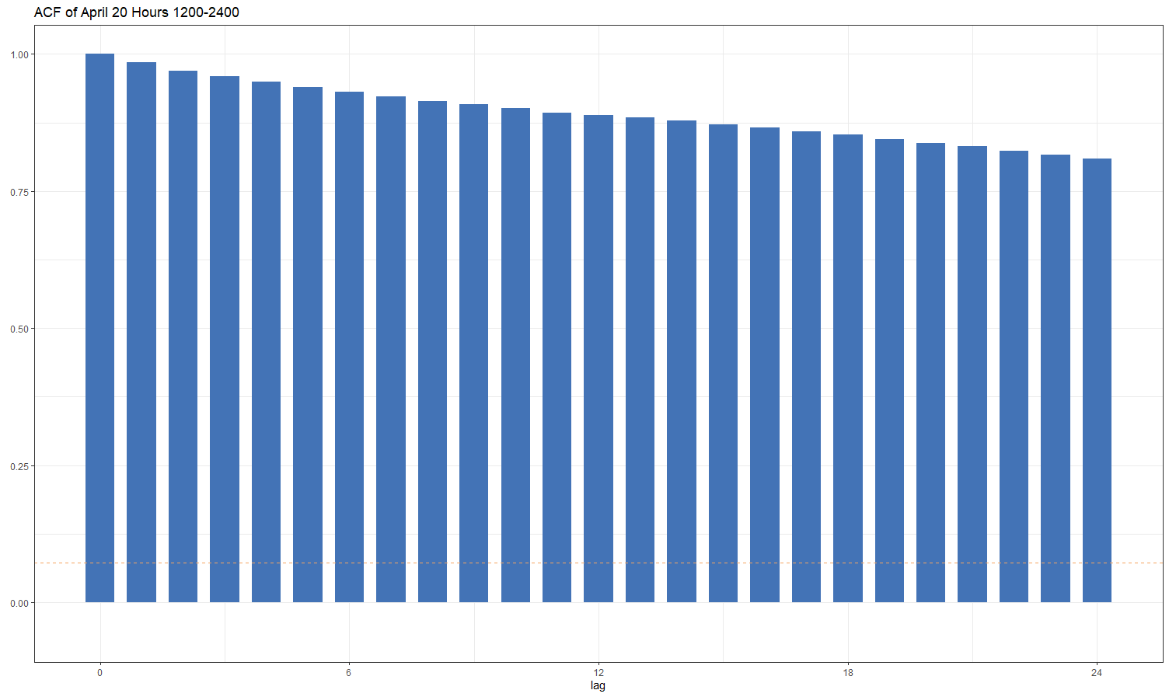
Stationarity Evaluation
Condition 1: Mean does not depend on time
Condition 2: Variance does not depend on time
Condition 3: Autocorrelations constant regardless of where we look in the series
Note the slight oscillation, particularly in the second half

Slide 8
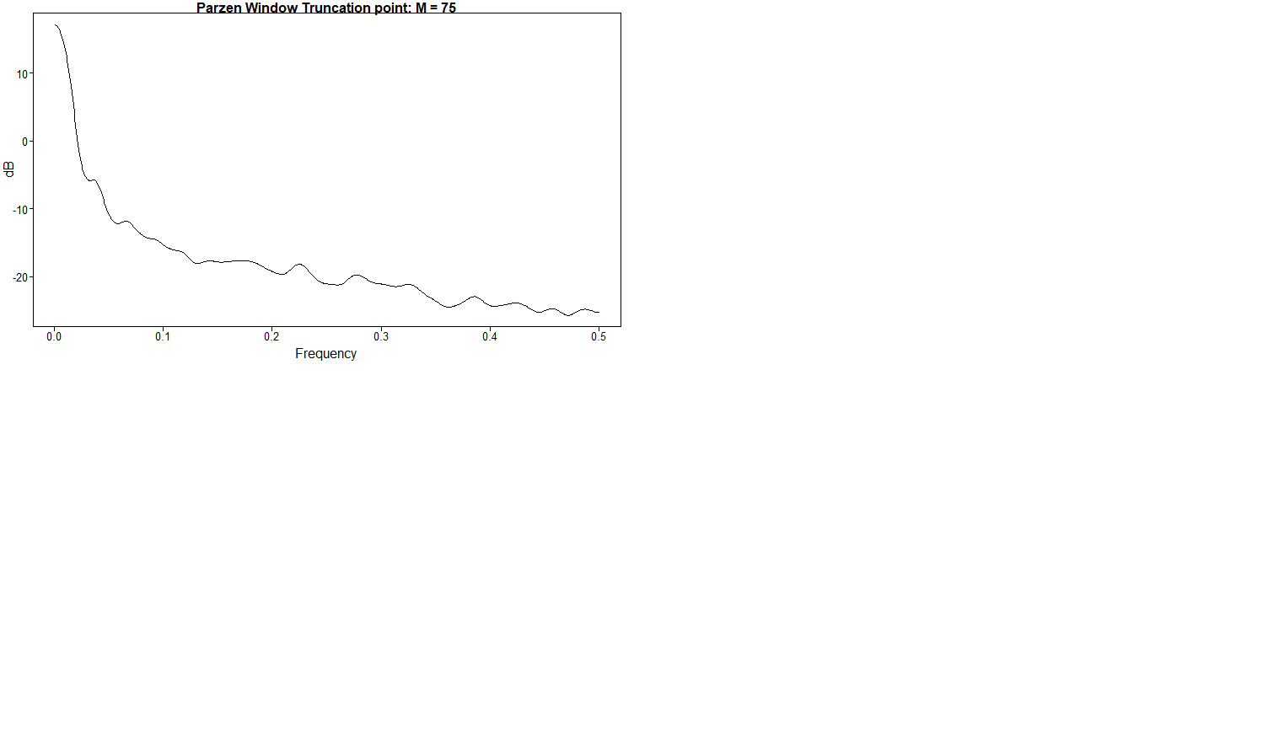
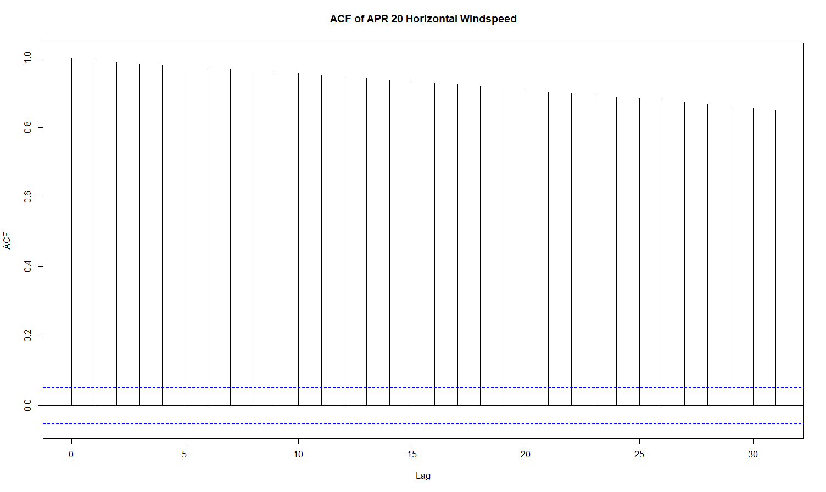
Spectral Density and Autocorrelation

Slide 9
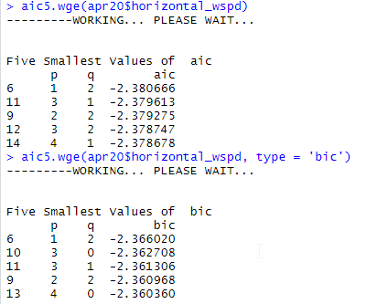
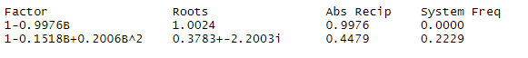
Potential Models
ARMA (1,2)
$\left(1−0.998B\right)\left(X_{t}−7.04\right)={(1−0.13B −0.22B^{2})a}_{t}$ ${\hat{σ}}_{a}^{2}=0.092$
ARMA (3,1)
$\left(1−1.149B+0.352B^{2}− 0.2B^{3}\right)\left(X_{t}−7.04\right)={(1−0.287B)a}_{t}$ ${\hat{σ}}_{a}^{2}=0.092$
Take note! Looks like the ARMA(3,1) was able to capture the small system freq at 0.22 we saw in the original Parzen SD

Slide 10
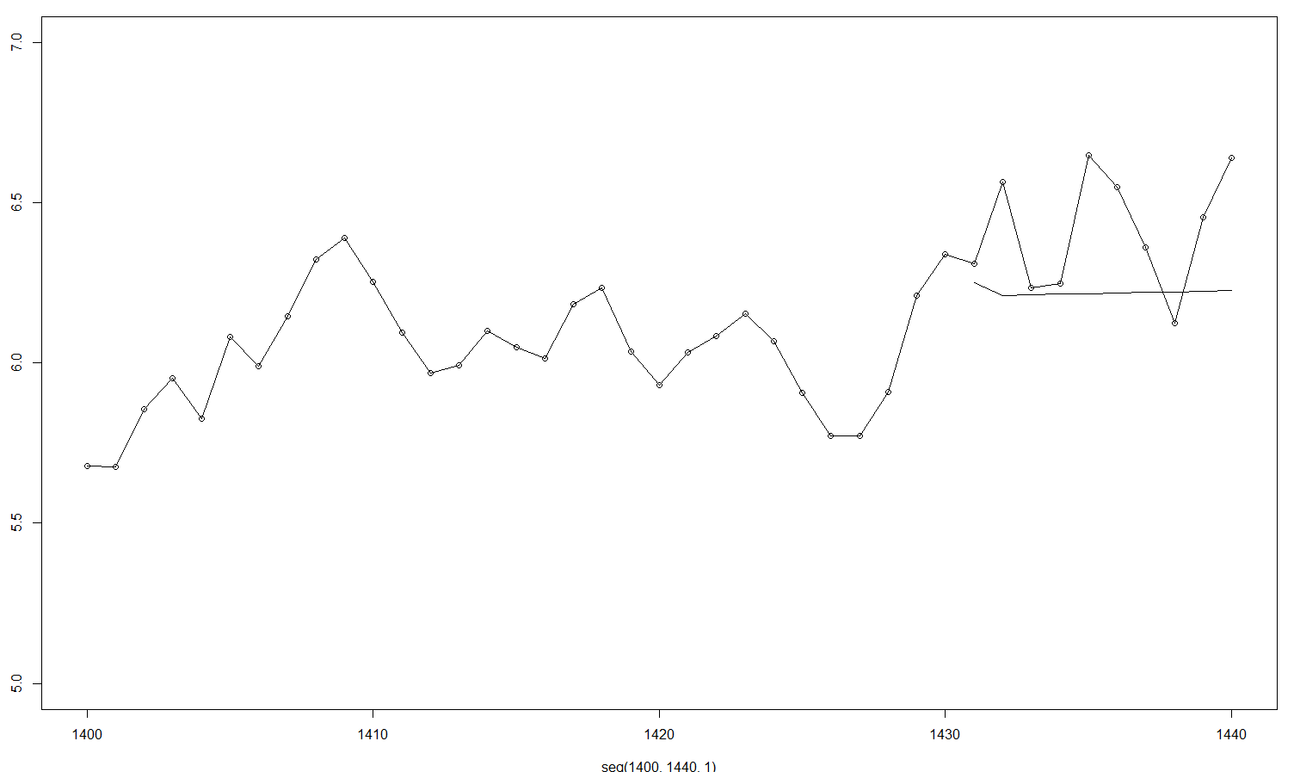
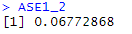

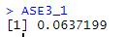
Forecast Evaluation (n.ahead = 10)

Slide 11

Plan for future analysis:
Continue to learn new techniques to model this series including:
Neural networks
Adding explanatory variables
Ensemble models
Continue to refine visualizations and explore how far to push forecast horizons while still maintaining reasonable accuracy.

